Slide 1



Kentucky Extension Homemakers Association
2024-2025
Blazing the Way with KEHA

Slide 2
KEHA Mission
Improving the quality of life
for families and communities
through
education, leadership development,
and volunteer service.
Notes:
KEHA’s primary mission is to improve the quality of life for families and communities through leadership development, volunteer service, and education.
This mission shares common emphasis and a strong connection to the Extension mission to make a difference in the lives of Kentuckians through research-based education.

Slide 3
KEHA - Education
Implement a program of work for your club and county.
  Address needs of members, individuals, and families in your communities, in the state, and around the globe.
  Include goals, lessons, and projects from the eight state educational chairmen’s programs of work.
  Connect club and county programs with the county FCS Extension plan of work.
Notes:
EDUCATION is a key emphasis of the KEHA mission. KEHA clubs and counties should implement an educational program of work each year.
<Review the three bullet points on the slide>

Slide 4
KEHA - Leadership
Empower community leaders.
  Provide leadership training opportunities for members.
  Take an active role in the community.
  Inform local decision-makers of the impacts and public value of KEHA and the Kentucky Cooperative Extension Service.
Notes:
LEADERSHIP is also an emphasis in KEHA, with a goal to empower community leaders.
<Review the three bullet points on the slide>

Slide 5
KEHA - Service
Embrace and promote volunteer service.
  Volunteer to serve in a club, county, or area leadership position.
  Support Extension programs through volunteer service.
  Report volunteer time through the volunteer service unit program and leadership development report.
Notes:
VOLUNTEER SERVICE is the culmination of KEHA education and leadership activities. All members are encouraged to embrace the spirit of service and to promote volunteer opportunities.
<Review the three bullet points on the slide>

Slide 6
2024-2025 Theme: Blazing the Way with KEHA
Reflects KEHA’s 92-year-strong journey
Just as it is more fun to travel with friends, KEHA’s commitment to service, education, and leadership is strengthened by all of us working together!
Consider the theme for:
  County and area annual meetings,
  Training and programmatic themes, and
  Promotional and membership activities.
Notes:
The KEHA theme for this year is “Blazing the Way with KEHA.” This theme reflects KEHA’s 92-year-strong journey. Just as it’s more fun to travel with friends, KEHA’s commitment to service, education, and leadership is strengthened by all of us working together!
We gain a sense of security and belonging from membership. And KEHA “covers more ground” with a broad variety of educational topics and volunteer service. Despite the vast terrain throughout the state, KEHA members, clubs, counties, areas, and the state organization all connect communities to each other and makes life better for families.
The theme can be used at all levels – by clubs, counties, areas, or statewide.
Potential uses include:
County and area annual meeting themes
Training and programmatic theme
Promotional and membership activities

Slide 7

President’s Focus – 2022-2025
Let Your Light Shine!
  Confidence – showcase KEHA work, publicize accomplishments, recognize local members, and keep lines of communication open.
  Guidance – encourage members to share talents for teaching others, host area officer trainings, recruit participants for the KEHA Leadership Academy, and work toward leadership development.
  Direction – grow and retain membership, follow directions using the KEHA manual, and encourage meetings.
Notes:
This marks the third year in Brenda Hammons’s three-year term as KEHA president. Her program of work is titled “Let Your Light Shine!” and emphasizes three key areas:
Confidence
Guidance
Direction
<Review the three bullet points on the slide>
What can we do at the club and county level this year to address one or more of these topics? How can we take new approaches to grow our membership?

Slide 8
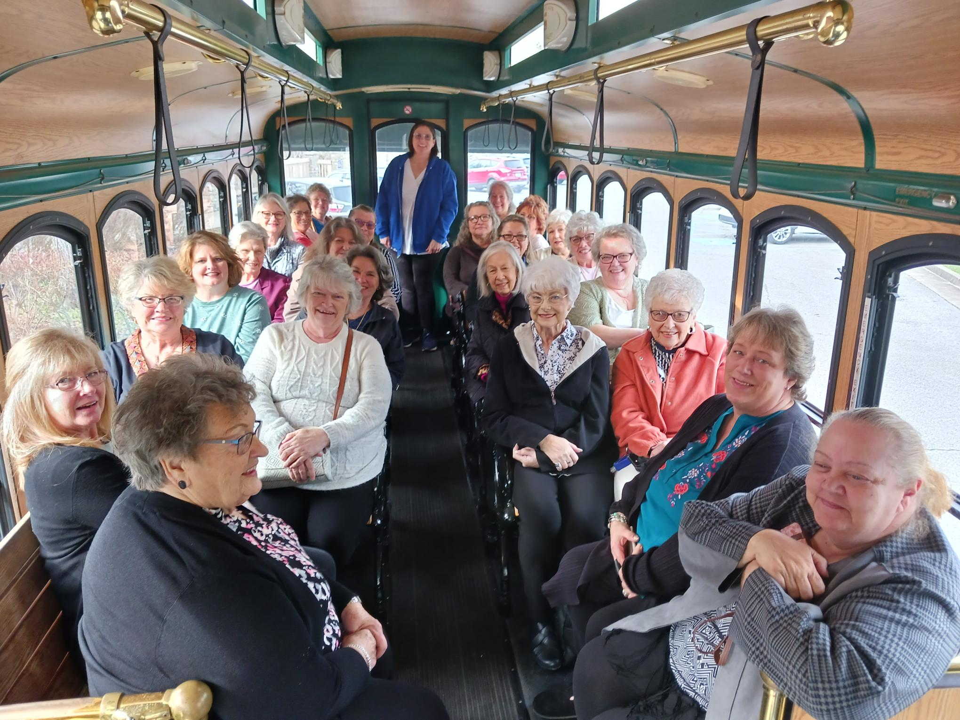
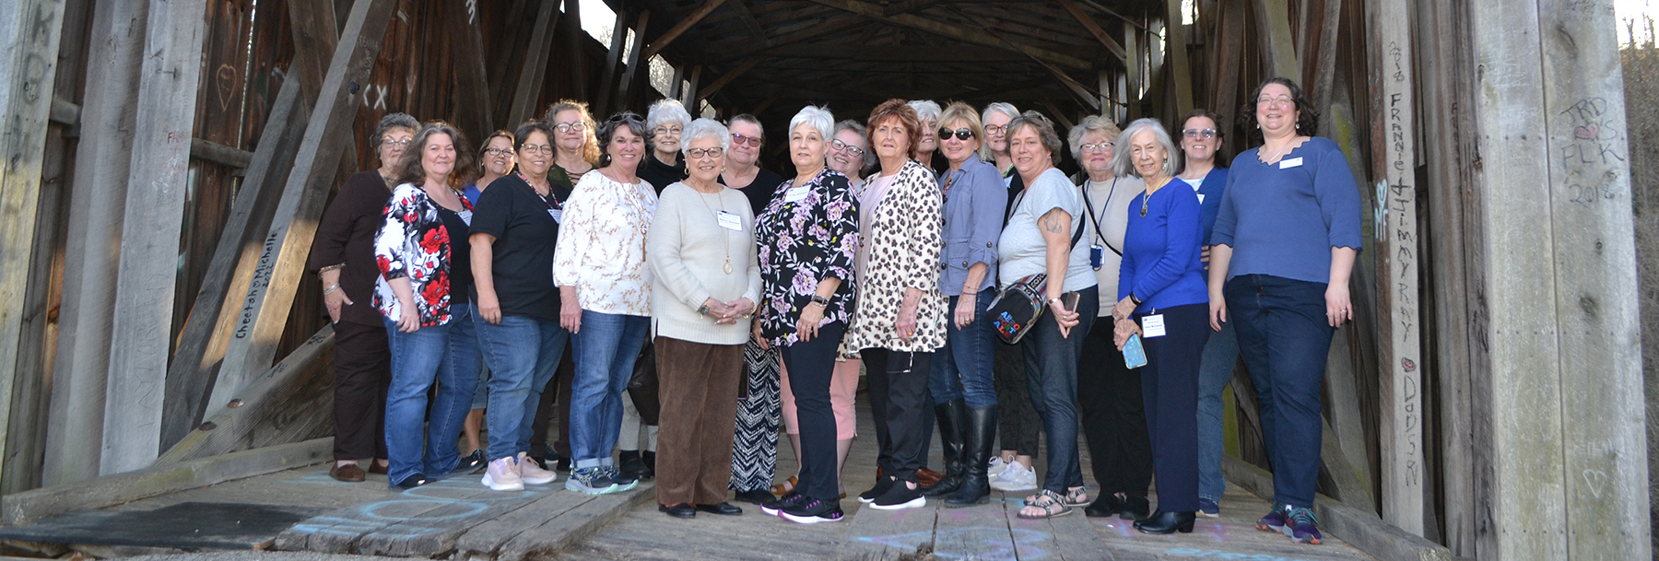
2023 KEHA Leadership Academy
2nd KEHA Leadership Academy in March 2023
Intensive leadership training targeted to new and emerging leaders
20 attendees from 18 counties
Volunteer service requirement included
Notes:
The second KEHA Leadership Academy was March 1-3, 2023, at Blue Licks Battlefield State Resort Park. The goal of the academy is to strengthen leadership skills for emerging leaders within the organization and increase the pool of leaders available to hold county, area, and state level elected and appointed positions.
The 2023 Leadership Academy had 20 attendees from 18 different counties. Also attending were six planning committee members from across the state and two UK Extension advisors.
The Leadership Academy curriculum focused on the following topics:
• KEHA History
• Understanding Personality Differences
• Leadership Characteristics
• The Basics of Teamwork
• Communication Skills
• Parliamentary Procedure
• Diversity and Cultural Competency
• Organizational Assessment
Within 30 days of attending, participants were to develop a plan to provide 40 hours of “payback” and submit the plan to the Leadership Academy Committee.
Twelve months after the Leadership Academy training, each participant will submit a report of payback hours to the Leadership Academy Committee. The committee is reviewing those payback hours now!

Slide 9
3 Rs – Keys to Membership
Recruit – Each member is encouraged to get a “plus 1”
Retain – Value your current members and keep them engaged
Repeat – Continue to grow each year
Each county that increases membership by at least 3 will be entered in a drawing for $100 (5 prizes available). The number of entries will increase for each multiple of 3 – an increase of 6 members is 2 entries, an increase of 12 members is 4 entries, etc.
Notes:
Outgoing KEHA 2nd Vice President Julie Hook previously set the emphasis for membership focused on encouraging everyone to continually recruit and retain new members.
Members will receive a chance at a drawing as an incentive to strive toward increasing membership.

Slide 10
Developing a Program of Work
Consider needs and interests in your club and county.
Review statewide programs and emphases.
Select components that fit with county needs and interests.
Build a calendar for the year.
Evaluate programs and submit your reports.
Celebrate and share your successes!!
Notes:
As was mentioned when we talked about the EDUCATION emphasis of the KEHA mission, all counties are encouraged to have an annual program of work.
Consider these things as you set county programs, priorities, and activities:
<Review the bullet points listed on the slide.>

Slide 11

Cultural Arts and Heritage
2022-2025 Focus:
Understanding, Appreciating, and Creating Art
2022-2023: Elements and Principles of Art
2023-2024: Composition in Drawing and Painting
2024-2025: Composition in Photography
Cultural Arts and Heritage Passport
Reading Awards and Creative Writing Contest
Notes:
For the next few minutes, we will shift our focus to the eight state educational chairmen programs of work.
This year, Cultural Arts and Heritage is reaching the end of the three-year program of work.
The 2022-2025 program of work for Cultural Arts and Heritage emphasizes the arts. For 2024-2025, the focus is on composition in photography.
The Cultural Arts and Heritage Passport contest encourages members to visit cultural, historical, and heritage sites; art museums; state parks; and more as health and safety guidelines allow. A printable passport has been developed and is available on the Cultural Arts and Heritage Chairman web page. It is recommended to print the cover on blue paper and the passport pages on white, double-sided. The files are set up with two booklets per page and can be cut prior to assembling, stapling, and folding.
Members are also encouraged to submit entries for the KEHA Creative Writing Contest.

Slide 12

Environment, Housing, and Energy
2024-2027 Focus:
Healthy Homes
Indoor Air Quality
Future topics coming soon!
Adopt-A-Highway Contest
Notes:
This year starts a new three-year program of work for Environment, Housing, and Energy.
The 2024-2027 Environment, Housing, and Energy program of work starts with a continued emphasis on healthy homes. A new leader lesson is available about Indoor Air Quality. The topics for years two and three are currently in development.
For those who have not yet used them, the lessons on Radon and Carbon Monoxide continue to be available for use.
Annual awards will recognize KEHA clubs and counties who participate in Kentucky’s Adopt-A-Highway contest. Many KEHA members across the state help keep a section of highway clear of trash through this program. If your club or county participates, be sure to send in the contest entry before March 1.

Slide 13

Family and Individual Development
2022-2025 Focus:
Self-Care
2022-2023: Self-Care and Mental Health: Living Alongside the Pandemic
2023-2024: Self-Care and Self-Indulgence
2024-2025: Self-Care and Strengthening Family and the Community
    Self-Care Contest
Notes:
This year, Family and Individual Development is reaching the end of the three-year program of work.
The 2022-2025 program of work for Family and Individual Development emphasizes self-care. For 2024-2025, the focus is self-care and strengthening family and the community.
New this year is the Self-Care Contest. Taking time to engage in self-care alleviates some of life’s daily pressures. The contest challenges participants to take meaningful day trips, describing three separate trips in a bound entry of up to five pages. Entries must be postmarked March 1.
Additional details are in the KEHA Handbook and on the KEHA website.

Slide 14

Food, Nutrition, and Health
2024-2027 Focus
2024-2025: Let No Child or Senior Go Hungry
2025-2026: Travel Kentucky from Your Kitchen
2026-2027: Food Culture in Other Countries
Ovarian Cancer Project
Promoting a Healthy Kentucky Contest
NEW! Let No Child or Senior Go Hungry Contest
Notes:
This year starts a new three-year program of work for Food, Nutrition, and Health.
The 2024-2027 Food, Nutrition, and Health program of work emphasizes hunger and food culture. For 2024-2025, the focus is on awareness of child and senior hunger. Members are encouraged to create and/or participate in hosting a “Blessing Box” in each county.
The Ovarian Cancer Project is an important part of the Food, Nutrition and Health chairmanship. Recognitions for ovarian cancer program contributions continue, as do the ovarian cancer fundraising contest and the “Promoting a Healthy Kentucky Contest.”
A new contest this year is the Let No Child or Senior Go Hungry Contest.

Slide 15
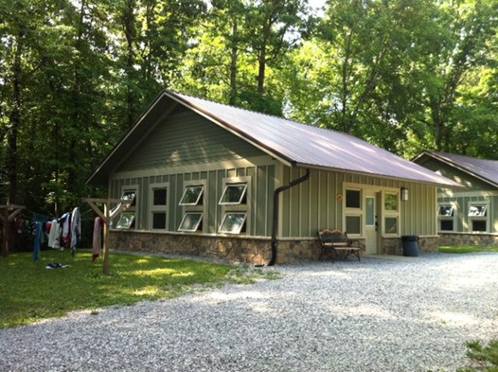
4-H Youth Development
2023-2026 Focus:
Connecting Homemakers and 4-H
2023-2024: Connecting with 4-H Agents
2024-2025: Heritage Skills
2025-2026: Healthy Living
Most Innovative 4-H and Extension Homemaker Partnership Project
Volunteer Hours for 4-H
4-H Camp Scholarships
Notes:
This year, 4-H Youth Development is in the middle of the three-year program of work.
The program of work focuses on connecting Homemakers and 4-H.
1st year - Connect with 4-H agents about starting clubs. Public speaking is a priority.
2nd year – Improve Homemakers and 4-H clubs’ collaboration.
3rd year - Build up momentum, increase number of 4-H clubs. Have project days. Multigenerational clubs such as walking clubs and cooking clubs.
The 4-H contests will recognize:
Volunteer service in support of 4-H
Donations for 4-H camp scholarships
KEHA and 4-H partnership projects
Be sure to submit the contest entry form to be considered for recognition!

Slide 16

International
2022-2025 Focus:
2022-2023: Updates from Ghana and the Philippines
2023-2024: Healthy Eating Around the World
2024-2025: Creating Communities that Welcome People
    Coins for Change
    Kentucky Academy/Ghana Library
    International Projects and Programs Award
Notes:
This year, International is in the middle of the three-year program of work.
The 2022-2025 program of work for International emphasizes creating communities that welcome people from other countries. For 2024-2025, the focus is on creating communities that welcome people with an all-new lesson.
Contests include:
International projects and programs award
Most coins collect awards for:
Coins for Change
Kentucky Academy/Ghana Library

Slide 17


Leadership Development
2024-2027 Focus:
Leadership – Encourage current and future leaders
Citizenship – Local participation
Volunteerism – Service to each other and our community
Scholarships – Support traditional and nontraditional students
Community Volunteerism Award
KEHA Scholarship Contributions
Volunteer Service Units
Notes:
This year starts a new three-year program of work for Leadership Development.
The 2024-2027 Leadership Development program of work includes four-part emphasis on citizenship, leadership, volunteerism, and scholarship.
Citizenship: Emphasis on voting and participation in local government.
Leadership: Focus on providing leadership development lessons and trainings for members, includes featured lesson on organizational analysis, goal setting, and action plans as well as an opportunity to enhance leadership skills through leadership book club and study options.
Volunteerism: The volunteerism component focuses on the KEHA Volunteer Service Unit program. Details for the program are included in the KEHA Manual and on the Leadership Development website. Remember to track and report your volunteer service units!
Scholarship: Support scholarships at the local and state level.
New lesson available on parliamentary procedure!
Awards include:
Community Volunteerism Award
KEHA Scholarship Contributions
Volunteer Service Units

Slide 18

Management and Safety
2023-2026 Focus:
Estate Planning and Money Management
2023-2024: Transferring Cherished Possessions and/or Emergency Health Information Cards
2024-2025: Estate Planning Basics
2025-2026: Stretching Your Dollar and/or Understanding Your Credit Score
Notes:
This year, Management & Safety is in the middle of the three-year program of work.
The program of work includes a wide variety of materials about estate planning, money management, spending, credit reports, and credit scores.
1st year - Transferring cherished possessions – making sure your family knows your wishes and/or Emergency Health Information Cards
2nd year – Basic Estate planning
3rd year – Stretching Your Dollar and/or Understanding Your Credit Score

Slide 19

Share Your Successes!
KEHA Reports
Assist in future planning,
Total to highlight impressive impacts statewide, and
Provide KEHA with information to spotlight clubs, counties, and areas!
Notes:
Each KEHA educational program area includes a report form to be completed annually. This is YOUR OPPORTUNITY to tell YOUR STORY and make sure YOUR WORK is reflected in the statewide data compiled through KEHA!!
Report forms:
Summarize impacts of KEHA programs across the state,
Assist KEHA Educational Chairmen in crafting programs and plans, and
Provide KEHA with information to spotlight clubs, counties, and areas!

Slide 20
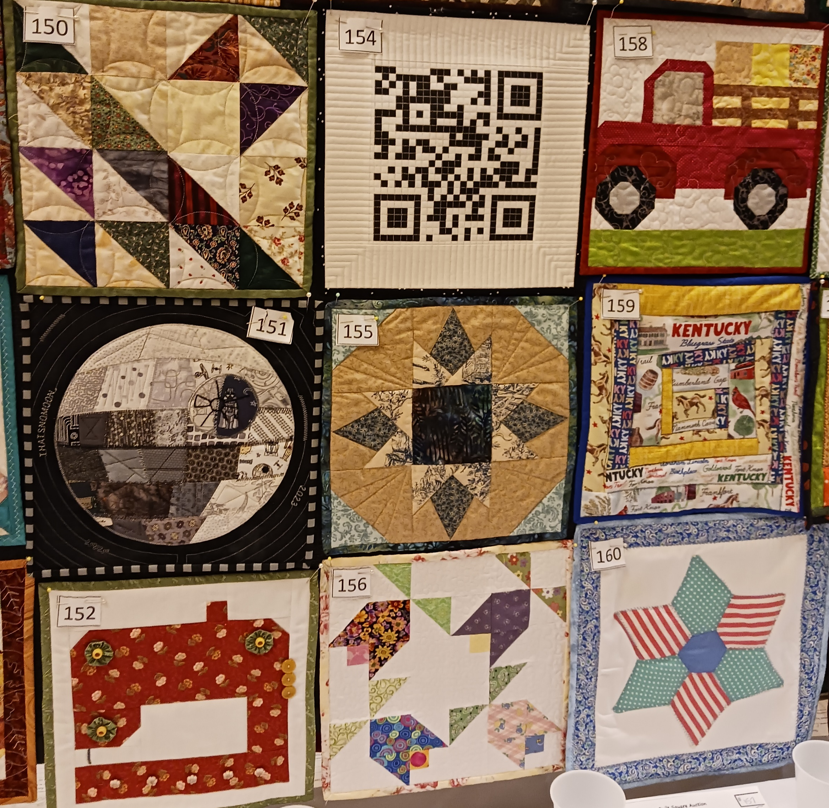

2022-2023 Report Highlights
Cultural Arts and Heritage
KEHA clubs and county organizations generated more than $36,600 to support KEHA and community projects through sales of cultural arts and crafts items.
Environment, Housing and Energy
More than 1,700 have learned the effects radon has on their health.
Notes:
Consider these data points from the 2022-2023 KEHA reports – and remember that most state educational chairmen only receive data from 80 counties or less! (These numbers would be even higher if everyone submitted reports!)
<Review bullet points>

Slide 21


2022-2023 Report Highlights
Family and Individual Development
About 1,600 members and family members participated in community projects as part of the self-care program of work.
4-H Youth Development
KEHA clubs and county organizations provided $29,133 in 4-H camp scholarships.
Notes:
Consider these data points from the 2022-2023 KEHA reports – and remember that most state educational chairmen only receive data from 80 counties or less! (These numbers would be even higher if everyone submitted reports!)
<Review bullet points>

Slide 22


2022-2023 Report Highlights
Food, Nutrition, and Health
More than 2,300 members bought fresh foods at a local farmers’ market.
International
KEHA counties and clubs raised $9,000 for Coins for Change.
Notes:
Consider these data points from the 2022-2023 KEHA reports – and remember that most state educational chairmen only receive data from 80 counties or less! (These numbers would be even higher if everyone submitted reports!)
<Review bullet points>

Slide 23


2022-2023 Report Highlights
Leadership Development
KEHA members and clubs reported more than 420,000 volunteer hours for community activities and events.
Management and Safety
More than 1,700 members indicated they feel prepared to protect their money from fraud because of KEHA programming.
Notes:
Consider these data points from the 2022-2023 KEHA reports – and remember that most state educational chairmen only receive data from 80 counties or less! (These numbers would be even higher if everyone submitted reports!)
<Review bullet points>

Slide 24

Dates to Remember
July
July 1 – Club program of work reports due to county
July 1 – VSU logs due to county leadership chair
July 16-18, 2024 – National Volunteer Outreach Network Conference – Ashville, N.C.
August
August 15 – County educational chairman program of work reports due via online forms
August 15 – County VSU reports due via paper forms
Notes:
There are important dates to keep in mind throughout the KEHA year, starting in July!
<Refer to bullet points on slide>
<Add any specific county and/or area dates as you present>

Slide 25

Dates to Remember
September
September 15 – Area VSU Reports due to the KEHA State Leadership Development Chairman
October
October 13-19 – KEHA Week
October 15 – Deadline for learning session proposals for the 2025 KEHA State Meeting
Notes:
<Continue referencing bullet points on slide; add any special county or area dates as you present>

Slide 26

Dates to Remember
November
November TBA – Fall KEHA Board Meeting
November 15 – 990N deadline for 501(c)(3)s with a June 30 fiscal year ending date
Notes:
<Continue referencing bullet points on slide; add any special county or area dates as you present>

Slide 27

Dates to Remember
December
December 1 – Membership dues due to county treasurer
December 15 – County KEHA dues due to the area treasurer and state treasurer
December 31 – County KEHA dues delinquent if not received by the KEHA state treasurer
December 31 – KEHA Membership Recognition Report due to the Area Vice President
Notes:
<Continue referencing bullet points on slide; add any special county or area dates as you present>
<Emphasize the need for members and clubs to have all dues to the county treasurer by Dec. 1 so county dues can be submitted to the area and state by the deadlines>
Dec. 31 is the deadline for counties to submit the KEHA Membership Recognition Report, KEHA Appendix page 17 to the area vice president or president. The area vice president will compile the information and submit an area report to the KEHA 2nd Vice President by Jan. 31.

Slide 28

Dates to Remember
March
March 1 - Due date for:
  KEHA Contest Entries
  KEHA Development Grant and Mini-Grant Applications
  KEHA Scholarship Applications
  Showcase forms for KEHA State Meeting
March TBA – Spring KEHA State Board Meeting in Lexington, KY
Notes:
<Continue referencing bullet points on slide; add any special county or area dates as you present>
<Emphasize the need for members to always alert your office of address changes so that Extension staff can ensure that their information is correct in the state mailing database>
March 1 is an important due date for KEHA! Most contest entries are due on this date. See the KEHA Manual, Appendix pages 2-3 for a full list of contests.
This is also the date to submit grant proposals, and the development grants are a great way for counties and areas to fund new projects and activities!!
The KEHA Evans/Hansen/Weldon Scholarship is open to a college student in Kentucky pursuing a degree in a family and consumer sciences field. The KEHA Member scholarship is open to a KEHA member working on a first degree or certification.

Slide 29

Dates to Remember
April
April 5 – Postmark deadline for credentials for:
  Secretary
  4-H Youth Development
  Management and Safety
Notes:
KEHA will elect a new secretary and two new state educational chairs in 2025. <review list on slide>.
Credentials for all these positions are due 30 days before the State Meeting so the credentials must be postmarked by April 5, 2025. Position descriptions are available on the KEHA website in the State Board section.

Slide 30

Dates to Remember
April/May
April 7 – Postmark deadline for early registration for the 2025 KEHA State Meeting
April 21 – Final postmark deadline for registration for the 2025 KEHA State Meeting
May 6-8 – 2025 KEHA State Meeting, Lexington, KY
Notes:
The postmark deadline to mail KEHA State Meeting registration at the regular rate will be April 7 in 2025.
Registrations mailed April 8 to April 21 will need to pay the late fee. The final cutoff to mail State Meeting registration will be April 21.
KEHA members will gather in Lexington for the State Meeting May 6-8, 2025.

Slide 31

Dates to Remember
June
KEHA Program Year Ends
Notes:
The KEHA year ends June 30! The month of June is a great time to finish up your club reports, prepare your volunteer service unit logs and submit those items to your county to meet the July 1 deadline.

Slide 32
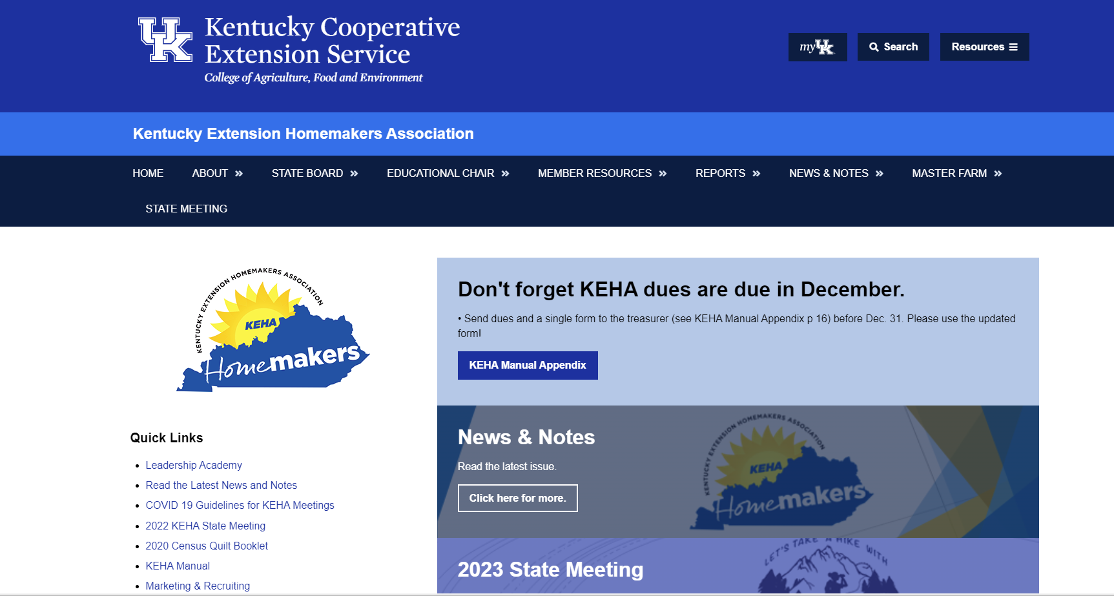

Stay in the Loop
Public Website: www.keha.org (https://keha.ca.uky.edu/)
www.facebook.com/OfficialKEHA
Annual Newsletter
KEHA News and Notes
County Newsletters and Social Media
Notes:
There are a variety of ways to stay current on KEHA news and happenings.
Visit the KEHA website often – www.keha.org.
Watch your mail each February for the annual KEHA newsletter.
Check the website each month for the latest edition of News & Notes.
Review each issue of your county newsletter for important updates and details.
Like and follow KEHA on Facebook and engage with club, county, and/or area social media pages.

Slide 33

Notes:
Always remember that KEHA benefits from teamwork! When KEHA members work together, we can achieve more at the club, county, area, and state levels!

