Slide 1
















KEHA 2025 Officer & Chairperson Training
Kickoff Presentation

Slide 2






KEHA Mission
Improving the quality of life
for families and communities
through
education, leadership development,
and volunteer service.

Slide 3








KEHA - Education
Implement a program of work for your club and county.
Address needs of members, individuals, and families in your communities, in the state, and around the globe.
Include goals, lessons, and projects from the eight state educational chairpeople’s programs of work.
Connect club and county programs with the county FCS Extension plan of work.

Slide 4




KEHA - Leadership
Empower community leaders.
Provide leadership training opportunities for members.
Take an active role in the community.
Inform local decision-makers of the impacts and public value of KEHA and the Kentucky Cooperative Extension Service.

Slide 5





KEHA - Service
Embrace and promote volunteer service.
Volunteer to serve in a club, county, or area leadership position.
Support Extension programs through volunteer service.
Report volunteer time through the Volunteer Service Unit (VSU) program and Leadership Development Chairperson report.

Slide 6





2025-2026 Theme:
Discover KEHA – A Hidden Treasure
KEHA has been a treasure to the state for 93 years.
By helping others “discover KEHA” it won’t remain “hidden.”
Consider the theme for:
County and area annual meetings,
Training and programmatic themes, and
Promotional and membership activities.

Slide 7




President’s Focus – 2025-2028
Theme: Stitched Together: A Plan for the Future
Purpose – What is your goal?
Planning – Choose your "pattern," gather your materials, recruit help, and keep the "threads" of communication open.
Product – Stay on task with tools and assistance, then publicize accomplishments.

Slide 8



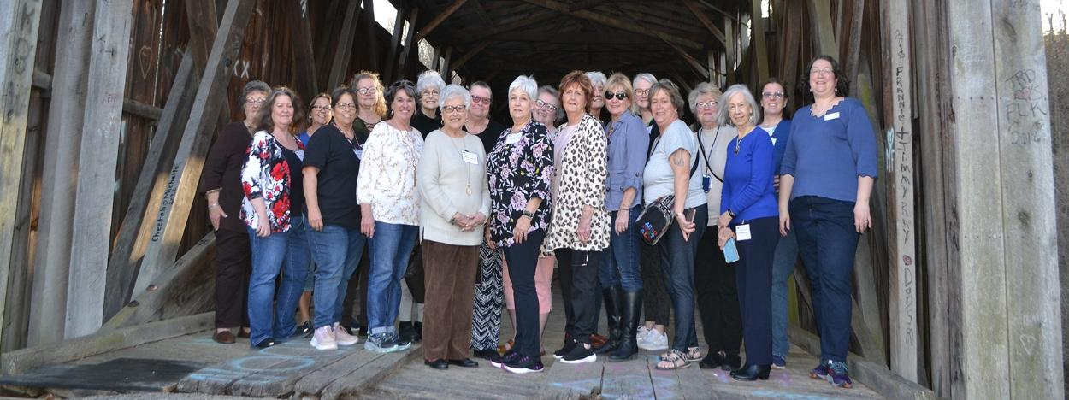

2026 KEHA Leadership Academy
3rd KEHA Leadership Academy in March 2026
Intensive leadership training targeted to new and emerging leaders
Volunteer service requirement included
Each area may send 2 nominees and 1 alternate
Apply at https://keha.ca.uky.edu/content/keha-leadership-academy
Photos from the
2023 KEHA Leadership Academy.

Slide 9


3Rs – Keys to Membership
Recruit – Add one member to your group yearly
Retain – Value your current members and keep them engaged
Repeat – Continue to grow each year
Each time a county gets 3 new members (above the previous year total), the county will be entered into a drawing. The number of entries will increase for each multiple of 3 – an increase of 6 members is 2 entries, an increase of 12 members is 4 entries, etc.
There will be five $100 prizes each year. The county with the highest number will receive a Golden Key to display.

Slide 10




Developing a Program of Work
Consider needs and interests in your club and county.
Review statewide programs and emphases. Consider the eight educational chairperson programs in the KEHA Manual Handbook.
Select components that fit with county needs and interests.
Build a calendar for the year.
Evaluate programs and submit your reports (July 1 club and Aug. 15 county/area).
Celebrate and share your successes!

Slide 11

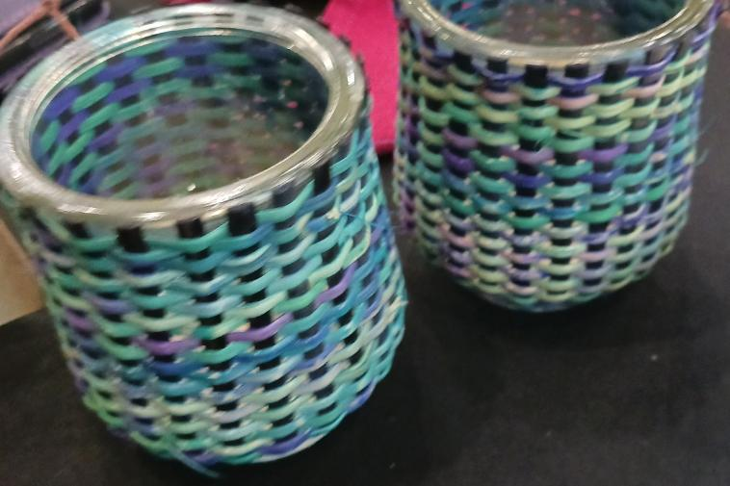


Cultural Arts and Heritage
2025-2028 Focus:
Cultural Arts Exhibits Awareness
2025-2026: Baskets
2026-2027: Fibers
2027-2028: Felting
Creative Writing Contest – due March 1
Passport Booklet Contest – due July 15
Cultural Arts Exhibits – State Meeting Display

Slide 12







Environment, Housing, and Energy
2024-2027 Focus:
Healthy Homes
Indoor Air Quality: Sources and Effects on our Health
Indoor Mold and Mildew
Radon in Kentucky
Carbon Monoxide: Exposure and Prevention
Adopt-A-Highway Contest – due March 1
https://stock.adobe.com/images/sunlight-illuminating-dust-particles-near-window-blinds-generative-ai/1282113854

Slide 13






Family and Individual Development
2025-2028 Focus:
Mental Health Stages Through the Ages
2025-2026: Mental Health Matters
2026-2028: Details coming soon!
2025-2026: Self-Care Contest (Travel) – due March 1
2026-2028: New Contest Coming Soon!

Slide 14







Food, Nutrition, and Health
2024-2027 Focus
2024-2025: Let No Child or Senior Go Hungry
2025-2026: Travel Kentucky from Your Kitchen
2026-2027: Food Culture in Other Countries
Ovarian Cancer Project
-Financial Contributions Awards – due with dues in December
-First-Time Ovarian Cancer Screenings – due with county reports
-Ovarian Cancer Fundraising Contest – due March 1
Let No Child or Senior Go Hungry Contest – due March 1
Food Culture in Other Countries – due March 1
Aaron Loeb

Slide 15




4-H Youth Development
2023-2026 Focus:
Connecting Homemakers and 4-H
2023-2024: Connecting with 4-H Agents
2024-2025: Heritage Skills
2025-2026: Healthy Living
Most Innovative 4-H and Extension Homemaker Partnership Project – due March 1
Volunteer Hours for 4-H – due March 1
4-H Camp Scholarships – due March 1

Slide 16

International
2025-2028 Focus:
2025-2026: Creating Welcoming Communities
2026-2027: Tips for Travel – Both Near and Far
Food Culture in Other Countries (work with FNH chair)
2027-2028: The Value of Learning a Foreign Language
Most Coins Collected Award – due with dues in December
-Coins for Change
-Kentucky Academy/Ghana Library
International Projects and Programs Contest – due March 1

Slide 17


Leadership Development
2024-2027 Focus:
Leadership – Encourage current and future leaders
Citizenship – Local government participation
Scholarships – Support traditional and nontraditional students
Volunteerism – Service to each other and our community
Community Volunteerism Award – due March 1
KEHA Scholarship Contributions – due with dues in December
Volunteer Service Unit (VSU) Program – due with county reports

Slide 18


Management and Safety
2023-2026 Focus:
Estate Planning and Money Management
2023-2024: Transferring Cherished Possessions and/or Emergency Health Information Cards
2024-2025: Estate Planning Basics
2025-2026: Stretching Your Dollar and/or Understanding Your Credit Score

Slide 19


Share Your Successes!
KEHA Reports:
Assist in future planning,
Highlight impressive impacts statewide, and
Provide KEHA with information to spotlight clubs, counties, and areas!

Slide 20

2023-2024 Report Highlights
Cultural Arts and Heritage
KEHA clubs and county organizations generated more than $22,700 to support KEHA and community projects through sales of cultural arts and crafts items.
Environment, Housing, and Energy
More than 1,800 have taken steps to make their homes safer.

Slide 21

2023-2024 Report Highlights
Family and Individual Development
More than 1,300 members and family members participated in community projects as part of the self-care program of work.
4-H Youth Development
KEHA clubs and county organizations provided $25,253 in 4-H camp scholarships.

Slide 22


2023-2024 Report Highlights
Food, Nutrition, and Health
More than 14,500 children were served by a local “backpack for hunger” program.
International
About 1,300 members participated in the “Healthy Eating Around the World” program.

Slide 23

2023-2024 Report Highlights
Leadership Development
KEHA members and clubs reported more than 786,000 volunteer hours for community activities and events.
Management and Safety
More than 1,600 members increased their understanding of what makes up an estate because of KEHA programming.

Slide 24


Dates to Remember
July
July – KEHA program year begins
July 1 – Club program of work reports due to county
July 1 – VSU logs due to county leadership chairperson
July 8-10, 2025 – National Volunteer Outreach Network Conference – Springfield, IL
August
August 15 – County educational chairperson program of work reports due via online forms
August 15 – County VSU reports due via paper forms

Slide 25

Dates to Remember
September
Membership drive begins
September 15 – Area VSU Reports due to the KEHA State Leadership Development Chairperson
October
October 12-18 – KEHA Week 2025
October 15 – Deadline for learning session proposals for the 2026 KEHA State Meeting

Slide 26


Dates to Remember
November
November TBA – Fall KEHA Board Meeting
November 15 – 990N deadline for 501(c)(3)s with a June 30 fiscal year end
December
December 1 – Membership dues due to county treasurer
December 15 – County KEHA dues due to the area treasurer and state treasurer
December 31 – County KEHA dues delinquent if not received by the KEHA state treasurer
December 31 – County Membership Recognition Report due to the Area Vice President

Slide 27
Dates to Remember
March
March 1 - Due date for:
KEHA Contest Entries
KEHA Development Grant and Mini-Grant Applications
KEHA Scholarship Applications
March 15 – Showcase forms for KEHA State Meeting
March TBA – Spring KEHA State Board Meeting in Lexington, KY

Slide 28

Dates to Remember
April
April 10 – Postmark deadline for state credentials for:
First Vice President
Treasurer
Environment, Housing, and Energy
Leadership Development
Food, Nutrition, and Health
Marketing and Publicity

Slide 29
Dates to Remember
April/May
April 13 – Reservation deadline for conference rate at State Meeting hotel
April 13 – Postmark deadline for early registration for the 2026 KEHA State Meeting
April 28 – Final postmark deadline for registration for the 2026 KEHA State Meeting
April 26-May 1 – Associated Country Women of the World (ACWW) Triennial Conference, Ottawa, Canada

Slide 30
Dates to Remember
May
May 12-14 – 2026 KEHA State Meeting, Lexington, KY
May 15 –990N deadline for 501(c)(3)s with a Dec. 31 fiscal year end
June
KEHA Program Year Ends

Slide 31
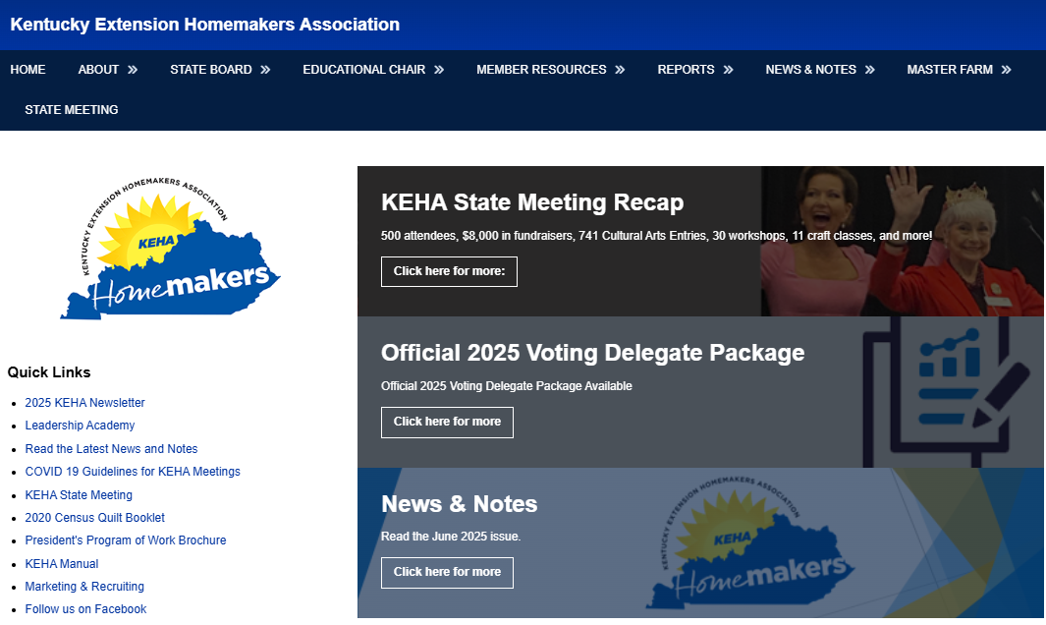


Stay in the Loop
Public Website: www.keha.org (https://keha.ca.uky.edu/)
www.facebook.com/OfficialKEHA
Annual Newsletter
KEHA News and Notes
County Newsletters and Social Media

Slide 32





Created July 2025
Art and photos by:
Canva, Adobe Stock Photography, and KEHA members and advisors

