Slide 1









KEHA 2025 Officer &
Chairperson
Training
Roles & Responsibilities

Slide 2
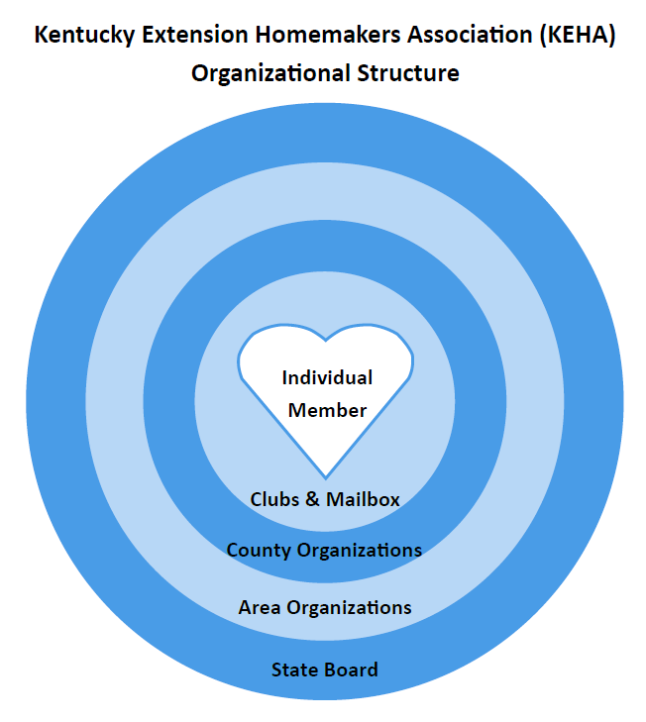



President
1st Vice President
2nd Vice President
Secretary
Treasurer
President Elect
Notes:
The individual member is at the heart of KEHA.
Levels within the organizational structure include:
Clubs and Mailbox Members
County Organizations
Area Organizations
State Board
Officers typically include:
President
1st and 2nd Vice President (or one Vice President)
Secretary
Treasurer
President-elect (sometimes)

Slide 3


Area Presidents
Represent the area on the KEHA Board of Directors.
Preside at all area meetings.
Give a brief report of the area activities at the KEHA Board of Directors’ meetings and the area council meetings.
Attend at least one meeting or event in each county of the area during your term.
Maintain a copy of the area bylaws and ensure they match state bylaws requirements; also ensure each county maintains a copy of county bylaws.

Slide 4


County Presidents
Preside at all county meetings.
Organize and call county council meetings.
Represent the county at area meetings.
Appoint committees as needed.
Make sure all county reports are submitted by set deadlines.

Slide 5

Club Presidents
Preside at all club meetings.
Represent the club at all county council meetings, planning sessions, and training meetings.
Report information back to your club.
Coordinate planning meetings for your club.
Submit club reports by set deadlines.

Slide 6



Area Vice Presidents
Attend all area meetings.
Serve as aide to the president.
Perform all duties of the president when the president is absent or unable to serve.
Implement, promote, and carry out KEHA educational programs.
Prepare and submit any required reports.

Slide 7


County Vice Presidents
Aide and assist the county president.
Preside at meetings in the absence of the president.
Coordinate county membership drives and recognition programs.
Assist in communicating activities and programs to membership.

Slide 8
Club Vice Presidents
Support the club president and other officers.
Carry out the duties of the president in their absence or as requested.
Promote your club’s programs and activities.
Serve as chair of the club membership activities.
Submit the club membership report as requested.

Slide 9

Area Secretaries
Serve as a member of the area executive committee.
Conduct roll call at all area meetings.
Record and preserve accurate minutes and records of all area council and business meetings.
Receive and send correspondence as needed and requested.
Follow guidelines for retaining minutes and correspondence.

Slide 10

County Secretaries
Serve as a member of the county executive committee.
Conduct roll call at all county meetings.
Record minutes of county council and county business meetings.
Handle county correspondence.
Follow guidelines for retaining minutes and correspondence.

Slide 11

Club Secretaries
Serve as a member of the club executive committee.
Conduct roll call at all club meetings.
Record minutes of club meetings.
Handle club correspondence.
Follow guidelines for retaining minutes and correspondence.

Slide 12


Secretaries Learn More!
KEHA Manual
https://keha.ca.uky.edu/content/keha-manual
Organizational Guide – page 21: Guidelines for writing minutes
Organizational Guide – page 22: How long do we keep records?
KEHA Club Materials – Record of Meetings
https://keha.ca.uky.edu/content/keha-club-materials

Slide 13
Area Treasurers
Receive and deposit area funds and pay approved bills.
Keep an accurate record of all area funds.
Prepare an annual budget for approval.
Present a detailed report of money received and dispersed at area council and business meetings.
Ensure area compliance with Extension financial guidelines and IRS filings (if applicable).

Slide 14
County Treasurers
Serve as a member of the county executive committee.
Present treasurer’s report at county meetings.
Lead preparation of the annual budget.
Submit dues to the KEHA State Treasurer and the area treasurer.
Keep a record of all financial transactions.
Ensure county compliance with Extension financial guidelines and IRS filings (if applicable).
Submit financial records for audit and review.
Aaron Loeb

Slide 15
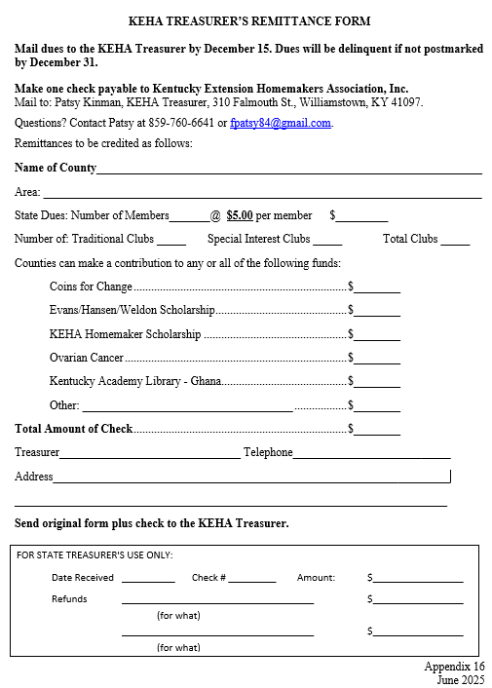

Dues Remittance Form
Forms are due by December 15.
They are delinquent if not postmarked by December 31.
Be sure funds totaled on the form are equal to the amount of the enclosed check or checks.
If using the “other” line, be sure to list a description in the blank.
Use most updated form from the
KEHA Manual Appendix online
https://keha.ca.uky.edu/content/keha-manual

Slide 16
Club Treasurers
Keep records of all financial transactions.
Collect membership dues and forward to the county treasurer.
Present treasurer’s report at club meetings.
Lead preparation of the annual budget for the club.
Ensure county compliance with Extension financial guidelines and IRS filings (if applicable).

Slide 17

Treasurers Learn More!
KEHA Manual online https://keha.ca.uky.edu/content/keha-manual
Organizational Guide
  Page 24: Suggestions for a county budget
  Page 25: Sample county budget
  Page 26: Annual budget form
  Page 27: Sample club treasurer’s report
  Page 28: Annual financial report form

Slide 18
Area Educational Chairs
Work with your area council to coordinate area program planning and implementation.
Serve as chairperson or co-chairperson for area workshops that relate to your chairmanship.
Communicate regularly with your corresponding state chairperson.
Promote and coordinate any contests at the area level (if applicable for your chairmanship).
Serve as a liaison between the state chairperson and the county educational chairpeople.
Share information and resources with the county chairpeople.
Ensure county program of work reports are submitted, and compile information to share within the area.

Slide 19
County Educational Chairs
Work cooperatively with your county council, county FCS agent, and area chairperson.
Attend area trainings and meetings related to your chairmanship.
Assist with program planning in your county.
Help plan tours, field trips, and special interest programs related to your chairmanship.
Promote chairmanship contests in your county.
Assist with leader training sessions and workshops related to your chairmanship.
Work with your county council and club leaders to complete program of work reports for your chairmanship.
Compile and submit the county program of work report by established deadlines.

Slide 20
Club Educational Chairs
Work with the county chairperson on program planning, implementation, and reporting.
Attend county leader trainings and workshops related to your chairmanship.
Teach club lessons related to your chairmanship.
Encourage club members to participate in chairmanship contests.

Slide 21

Members
Recruit new members.
Teach a lesson or lead an activity.
Participate actively in KEHA at all levels – club, county, area, and state.
Volunteer – to support KEHA, for Extension programs, and for community activities.
Tell YOUR KEHA story!

Slide 22

Remember …
Together
WE
Achieve
More
Created July 2025
Art and photos by:
Canva and KEHA members and advisors

